Slide 1

Product Ranking
In E-commerce using Elasticsearch
Torabazari Esmaeil
Master Student

Slide 2

What should we know about Product Ranking
01
What is Product Ranking?
02
Why it Matters
Directly Impacts Revenue
Directly Impacts Revenue
The process of ordering products for a given search query or category page
Top results get the most clicks and conversions
Defines Customer Experience
It's the crucial link between a customer's intent and a business's goals.
Good ranking feels intuitive and helpful; bad ranking feels broken.
A Strategic Business Lever
Allows merchandising teams to execute sales strategies directly within search results.

Slide 3




The Role of Elasticsearch More Than Just a Search Box
Speed and Scalability
Powerful Text Analysis
Flexible Query DSL
Real-time Analytics
Handles massive catalogs and high query volumes with millisecond response times
Understands user queries, handling typos, synonyms, and language-specific nuances
Provides a rich, JSON-based language to build complex ranking logic.
Ability to aggregate and analyze data, which can be fed back into ranking models.

Slide 4

Core Ranking: Text Relevance with BM25
BM25 (Best Match 25)
The modern default algorithm for scoring text relevance in Elasticsearch.
01
02
Term Frequency (TF)
Inverse Document Frequency (IDF)
How often does the search term appear in the product's description?
How rare is the term across all products?

Slide 5
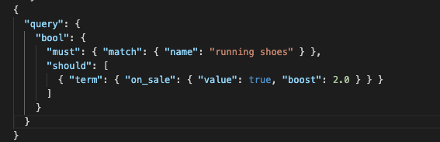
Core Ranking: Simple Merchandising with Boosting
Boosting allows you to influence the score of documents that meet certain criteria. It's the first step in applying business rules.
Examples

Slide 6
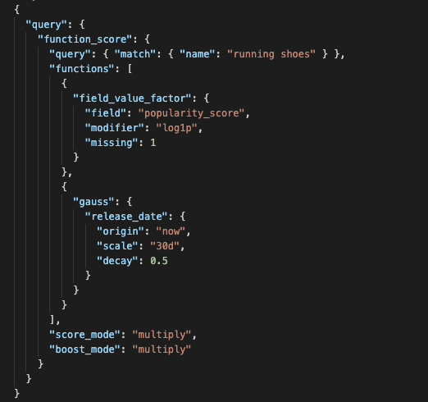
Hibrid Ranking: With function_score()
The `function_score` query is the primary tool for blending text relevance (the BM25 score) with multiple business signals.

Slide 7
The Merchandiser's Toolbox - Key Business Signals
These are the numerical signals we feed into our `function_score` query.
01
01
01
01
02
Popularity
02
Profitability
Popularity
Profitability
Sales velocity, page views, or add-to-carts in the last 30 days
Boost high-margin products
Sales velocity, page views, or add-to-carts in the last 30 days
Boost high-margin products
01
01
01
03
02
Freshness
04
Promotions
Promote new arrivals
Explicitly boost products part of a marketing campaign.
Inventory
02
02
06
05
Boost items with healthy stock levels; penalize or hide low-stock items.
Seller Rating
Boost products from trusted, high-performing sellers

Slide 8
The Limits of Manual Tuning
Learning to Rank (LTR) - Uses machine learning
Manual tuning refers to the process where human experts, such as merchandisers or search engineers, manually define and adjust the weights, boosts, and logic within the search algorithm (like `function_score` in Elasticsearch) to influence product ranking. This involves making qualitative decisions about the relative importance of various business signals and relevance factors.
The Challenge of Complexity
ith dozens of signals (popularity, margin, stock, reviews), how do you prioritize
Is a 5-star review score more important than a 10% profit margin
Is a product with 100 sales in the last 7 days better than one with 500 sales in the last 60 days

Slide 9
The Solution: Learning to Rank (LTR)
LTR automates the complex tuning process. It looks at thousands of past user decisions to build a model that can score products far more accurately than any human-tuned formula. This is the move from being reactive to being predictive.
01
02
A Shift in Mindset
How LTR Works in Practice
Old Way (Rules) : We tell the system what we think is relevant
Collect Training Data Log user queries and which products they click, add to cart, or purchase. These user actions are our "relevance judgments.
Train an ML Model: trained to predict the probability of a user action
Deploy to Elasticsearch:The trained model is uploaded to an Elasticsearch plugin and used to intelligently re-rank the top results for every query
New Way (LTR) : We let the system learn what is relevant from user behavior.t

Slide 10


The Future of Ranking
Vector Search & Hyper-Personalization
LLM Re-ranking
Goes beyond keywords to understand the meaning behind a query. Powered by machine learning models to create embeddings
Using Large Language Models to re-rank the top 20-50 results from Elasticsearch for ultimate relevance, providing a conversational and nuanced ordering.

Slide 11

Conclusion
Effective product ranking is not an IT problem; it is a core business strategy. It transforms the search box from a simple utility into a dynamic, revenue-driving merchandising tool.The path to maturity is an evolutionary journey, starting with strong text relevance, layering on critical business rules, and ultimately progressing to data-driven, machine-learned relevance with LTR. Elasticsearch provides the essential, scalable, and flexible toolkit for every stage of this journey, empowering teams to find the optimal balance between customer intent and business objectives.

